Slide 1


Docker-compose in 20mn
https://docs.docker.com/compose/compose-file/

Slide 2


What is docker-compose
Docker Compose is a tool for running multi-container applications on Docker
It means that as you have notice with docker run command we can only spin (deploy) only one (01) container at the same time, but with docker-compose we can run multiple containers at the same time using a single command

Slide 3

Warning
There are two type compose
docker-compose
And
docker compose - - - (V2)

Slide 4

Warning
docker-compose
docker compose

Slide 5


Warning
For now learn to type
Docker-compose
docker compose - - - - no no no

Slide 6
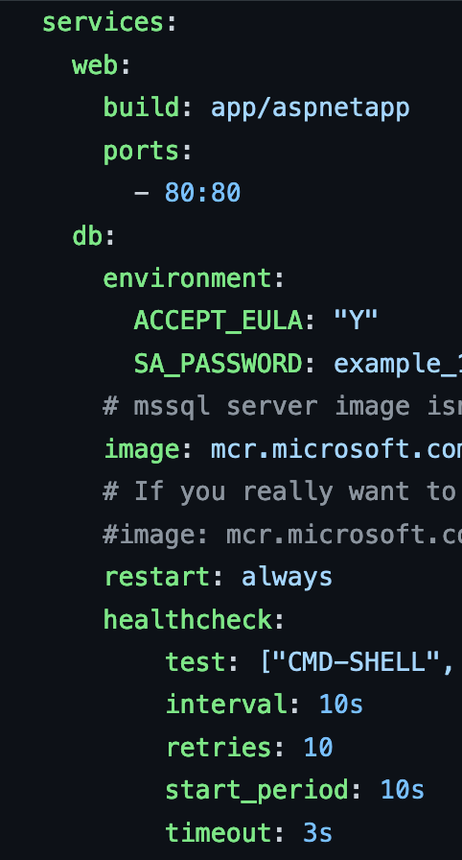

Language
docker-compose is written in

Slide 7



Structure
version
services
declaration

Slide 8
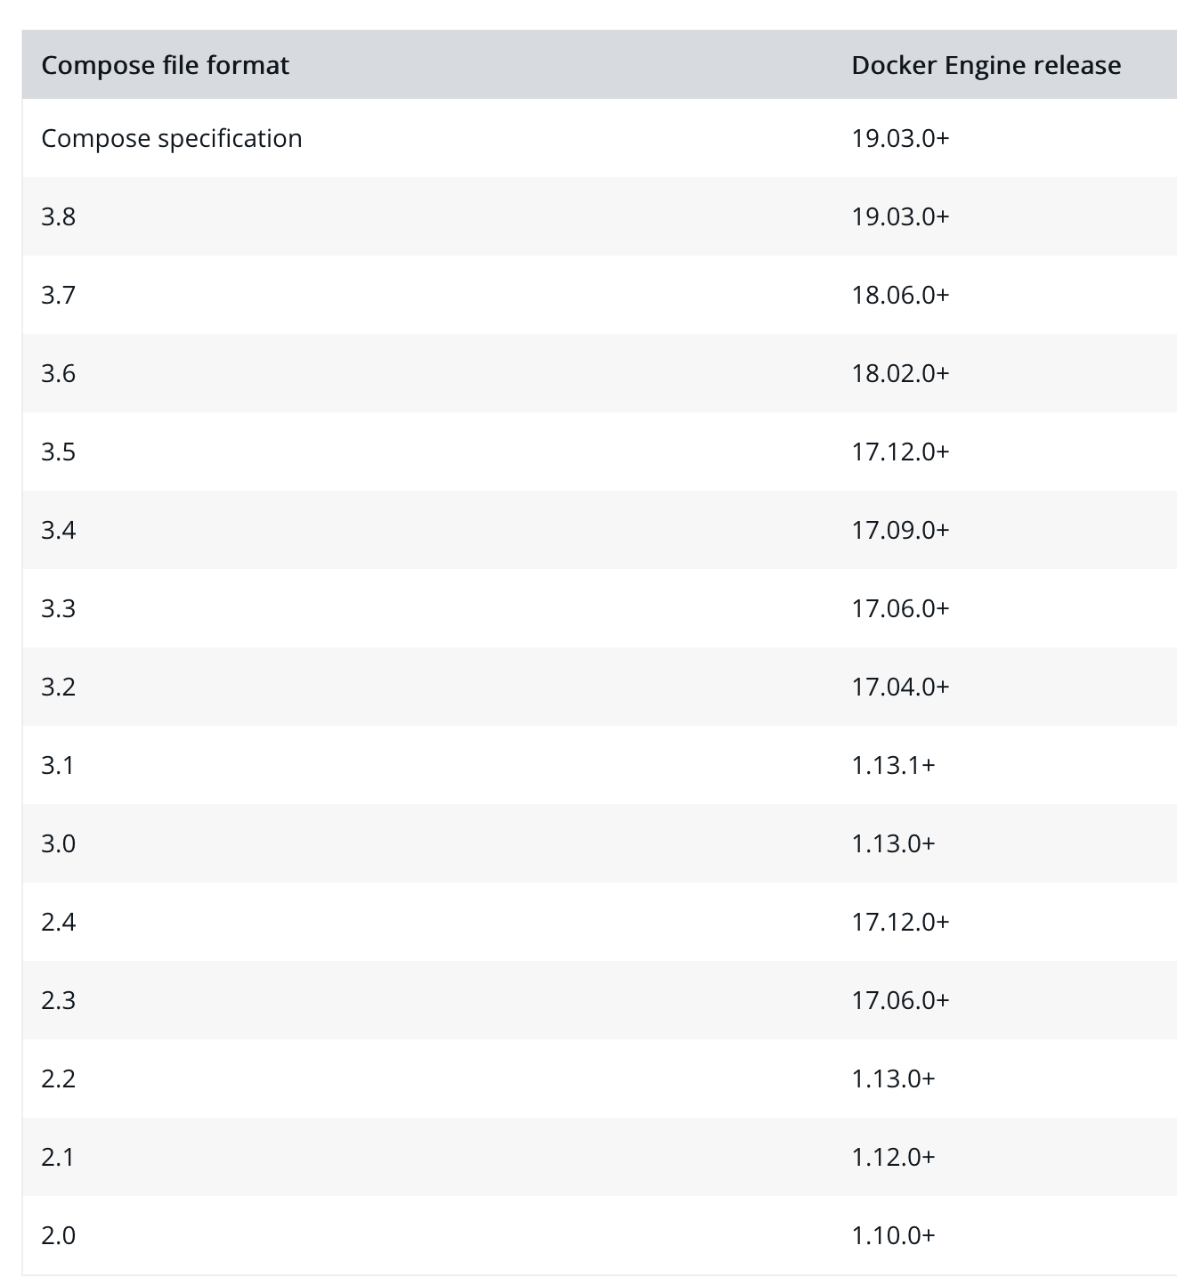
Structure
version
This set the version of the compose file and the version number is controlled by docker by best practices for now use version above or equal to “3”
https://docs.docker.com/compose/compose-file/compose-versioning/
services
declaration

Slide 9
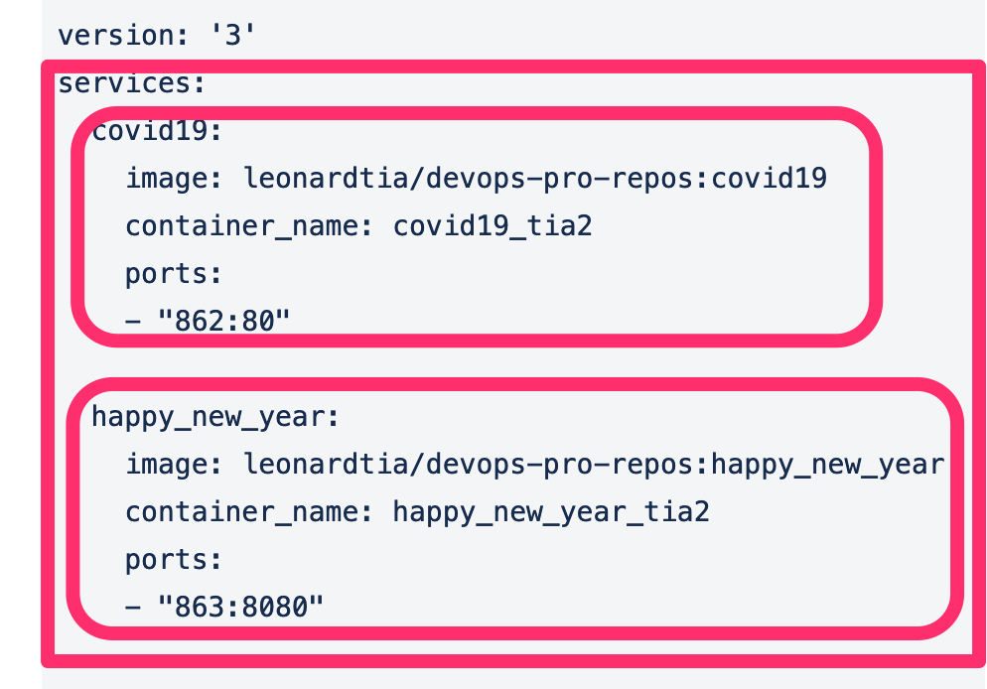
Structure
version
This section list all services and each service represent a container that docker will run, so if you have 3 services docker will run 3 containers if you have 10 service docker will run 10 containers
services
02 services
Therefore 02 container will be runned
declaration

Slide 10
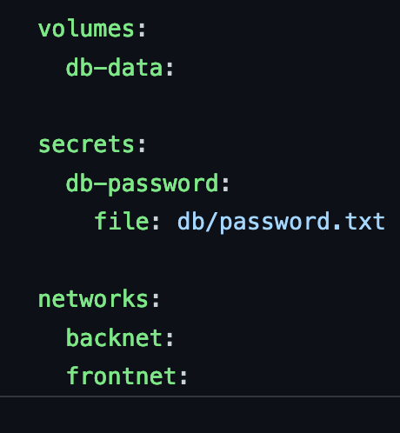
Structure
version
This section is optional and we only use this when we have used network, volume,secrets on services
services
declaration

Slide 11

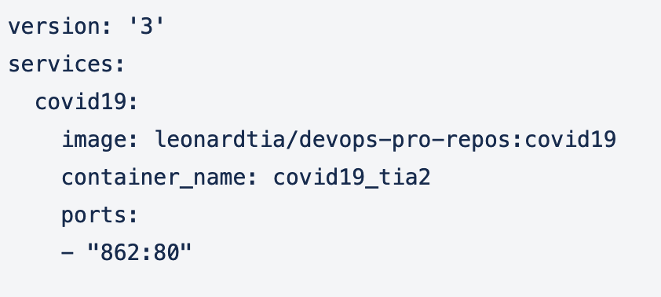
Components: version
version: [“version_number”]

Slide 12
Structure: service options
This means on every service the image must be set of course to run a container we need at least an image right !
image
command
restart
volumes
networks
environment
expose
ports
depends_on
hostname container_name
working_dir
entrypoint
These are optional and depend on the application

Slide 13
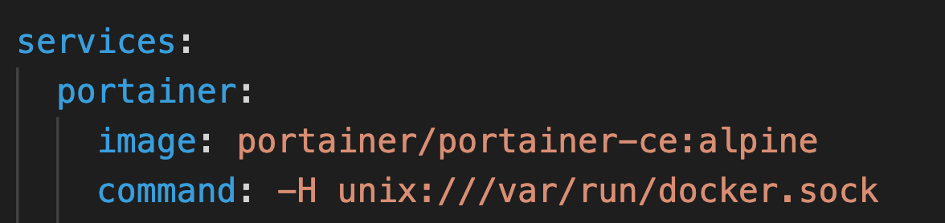
Structure: service options
command
restart
volumes
networks
environment
expose
ports
depends_on
hostname container_name
workdir
entrypoint
If you want to run a specific command when your container start you use the command option
The order does not matter command can come before image

Slide 14
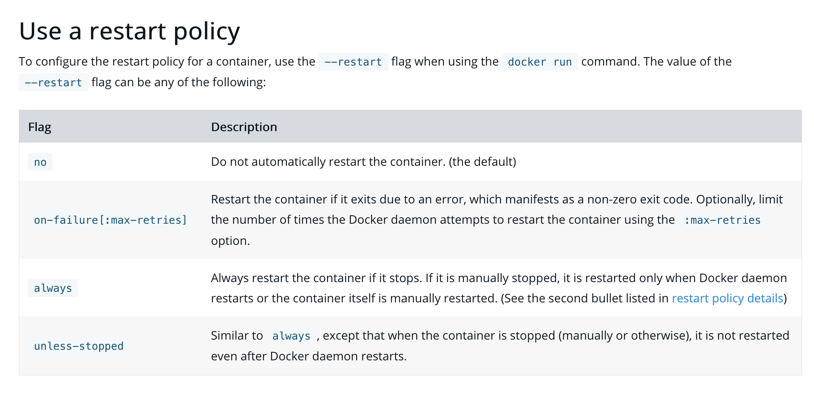
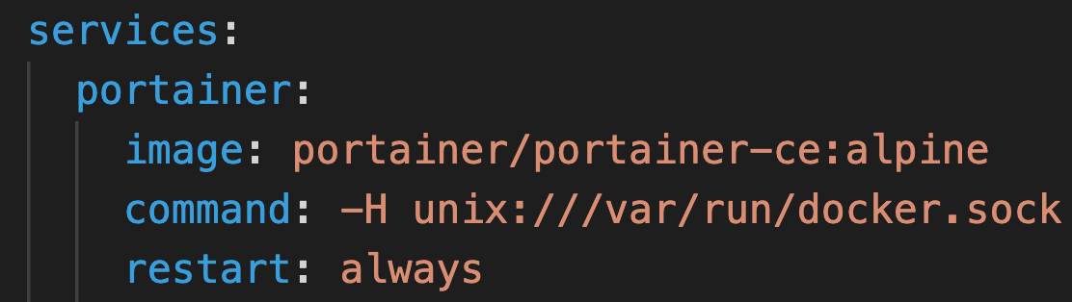
Structure: service options
command
restart
volumes
networks
environment
expose
ports
depends_on
hostname container_name
working_dir
entrypoint
In can you want to restart your container automatically when it fails you use the restart option

Slide 15
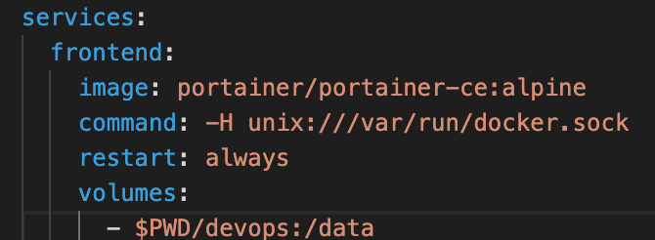
Structure: service options
command
restart
volumes
networks
environment
expose
ports
depends_on
hostname container_name
working_dir
entrypoint
In can you want to persist a volume use the volumes option
You can persist as many volumes as needed just add them as a list
Heyyyyy! volumes and not volume

Slide 16
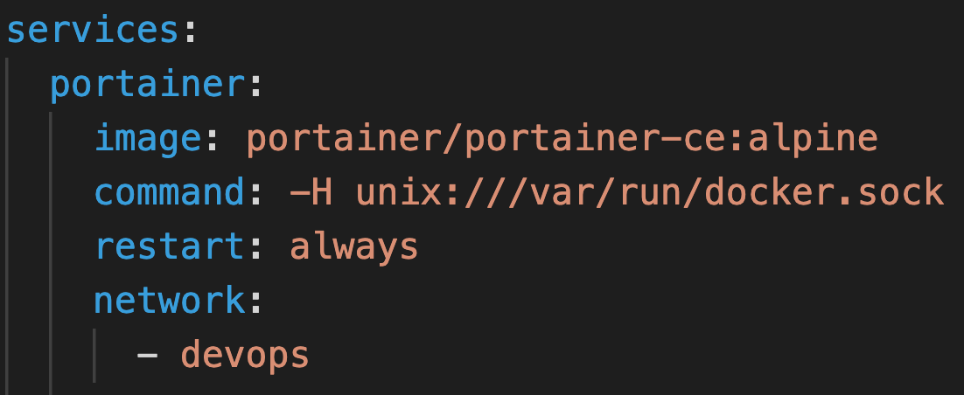
Structure: service options
command
restart
volumes
networks
environment
expose
ports
depends_on
hostname container_name
working_dir
entrypoint
If you want to add the container to a network different than the default network use network option this is very usable when you want to make multiple containers talk together you just have to add them under the same network
WHY ?
Well, people leaving in the same house communication easily compared to when they leave in different houses.

Slide 17
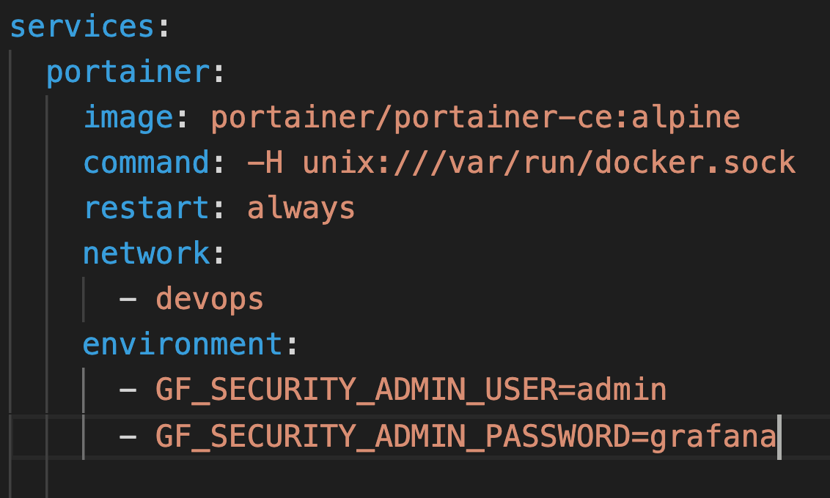
Structure: service options
command
restart
volumes
networks
environment
expose
ports
depends_on
hostname container_name
working_dir
entrypoint
If you want to create environment variable use the option environment.
Very useful for databases
This the equivalent of ENV in the Dockerfile
It means with docker-compose we can create missing elements from Dockerfile
You can have multiple environment variable, just add them as a list

Slide 18
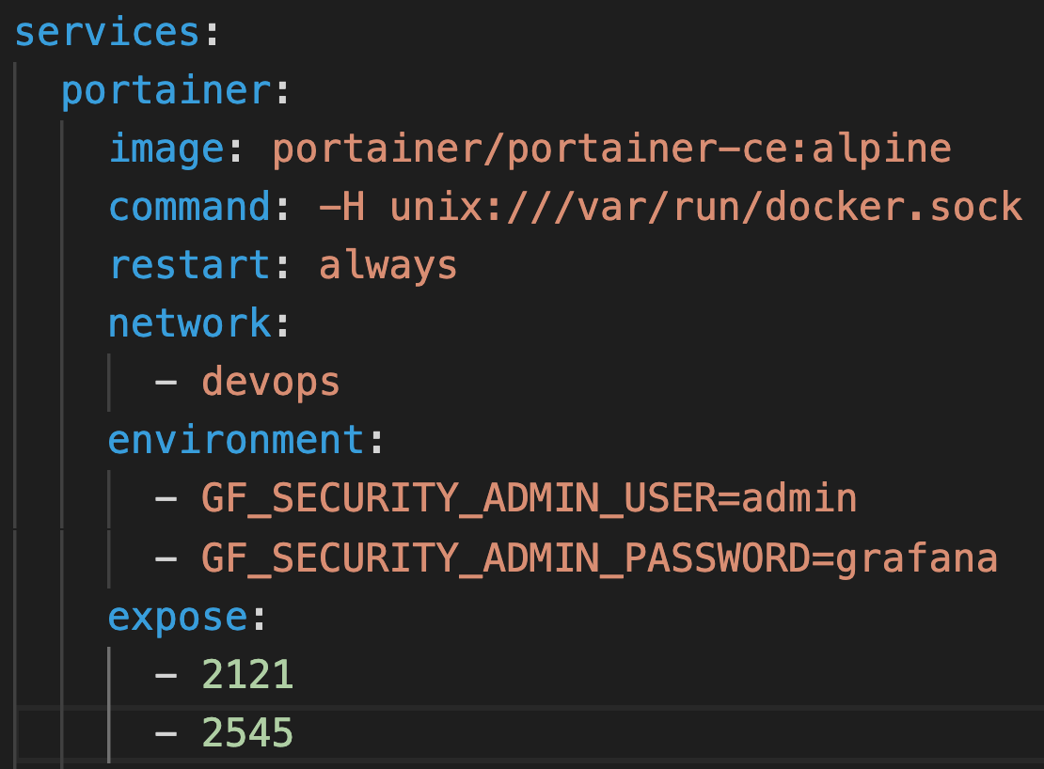
Structure: service options
command
restart
volumes
networks
environment
expose
ports
depends_on
hostname container_name
working_dir
entrypoint
If you want to open port inside the container just use expose
This the equivalent of EXPOSE in the Dockerfile
It means with docker-compose we can create missing elements from Dockerfile
You can expose as many port as needed just add them as a list

Slide 19
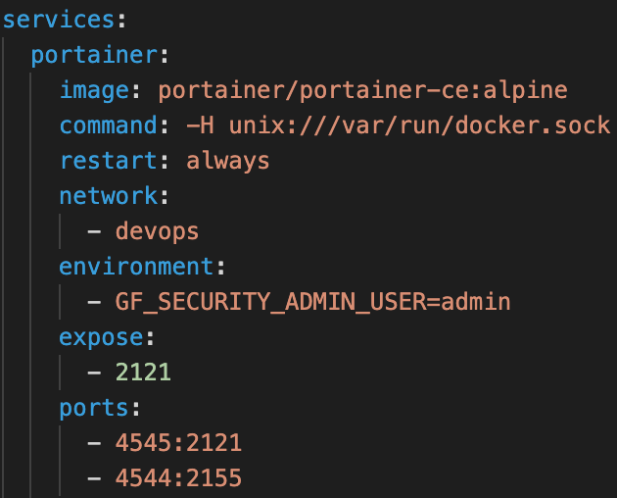
Structure: service options
command
restart
volumes
networks
environment
expose
ports
depends_on
hostname container_name
working_dir
entrypoint
If you want to map a port so that you can access your application on the browser just use ports
You can open as many port as needed just add them as a list
Heyyyyy! ports and not port

Slide 20
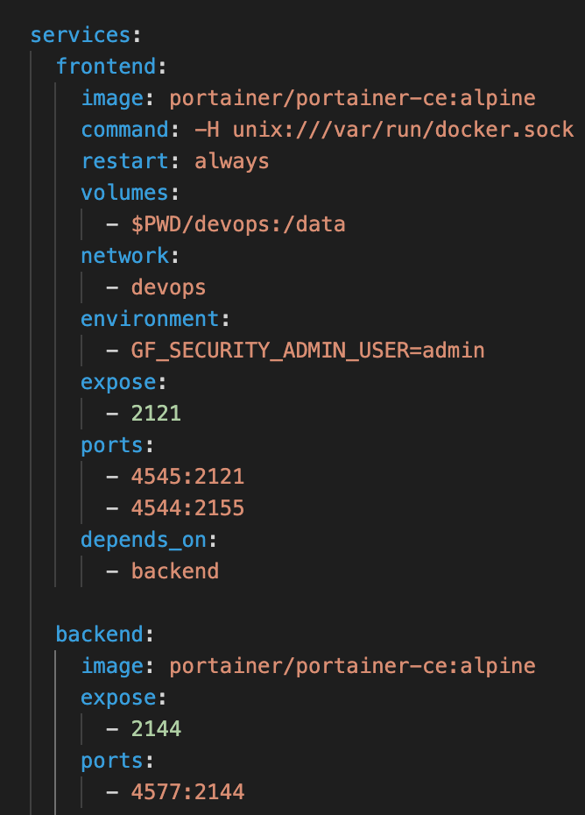
Structure: service options
command
restart
volumes
networks
environment
expose
ports
depends_on
hostname container_name
working_dir
entrypoint
If your want to control the flow or sequence on when services will be runned in others words the order in which docker should run containers use depends_on
Heyyyyy! depends_on and not depend_on
You can have multiple dependencies per service as needed just add them as a list
So as you can see the service frontend depend on the backend service meaning docker will first start the backend service first then the frontend service later on
In order words docker please start the backend container first then the frontend container when the backend container is running

Slide 21
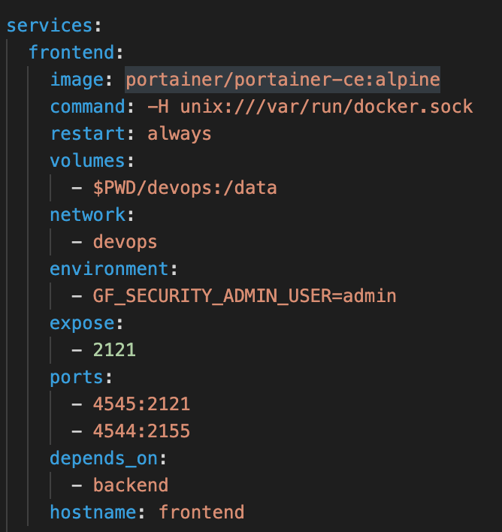
Structure: service options
command
restart
volumes
networks
environment
expose
ports
depends_on
hostname container_name
working_dir
entrypoint
If you want to set the hostname meaning the name in which other containers will recognized your container use hostname option

Slide 22
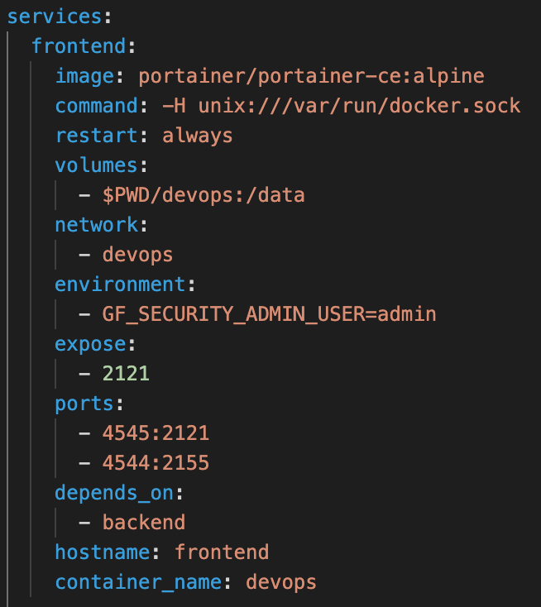
Structure: service options
command
restart
volumes
networks
environment
expose
ports
depends_on
hostname container_name
working_dir
entrypoint
If you want to set the name on the container (I will advise you to always do) use container_name option

Slide 23
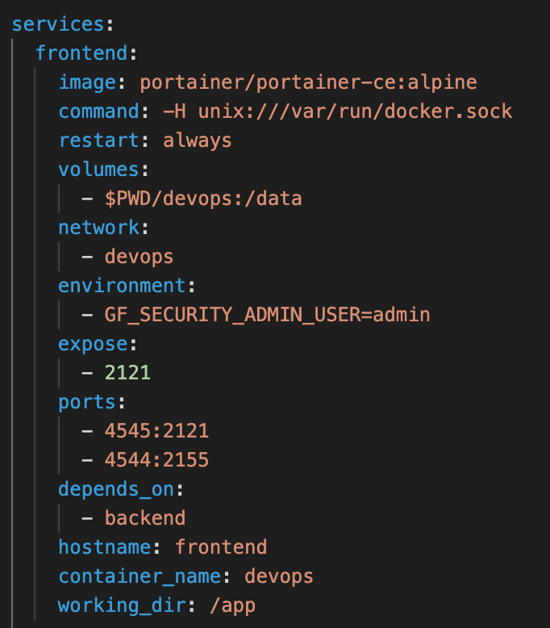
Structure: service options
command
restart
volumes
networks
environment
expose
ports
depends_on
hostname container_name
working_dir
entrypoint
If you want to set the default working directory use the working_dir option
This is same as WORKDIR in Dockerfile

Slide 24
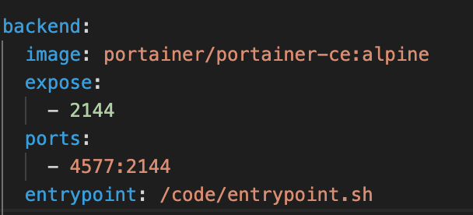
Structure: service options
command
restart
volumes
networks
environment
expose
ports
depends_on
hostname container_name
working_dir
entrypoint
If you want to set an entrypoint meain the first command docker run when the container start use entrypoint option
But I will advise you to set this on the Dockerfile
This is same as ENTRYPOINT in Dockerfile

Slide 25
Structure: services rules
1- containers cannot map under the same ports
2- containers cannot have the same name
3- service cannot have the same name

Slide 26
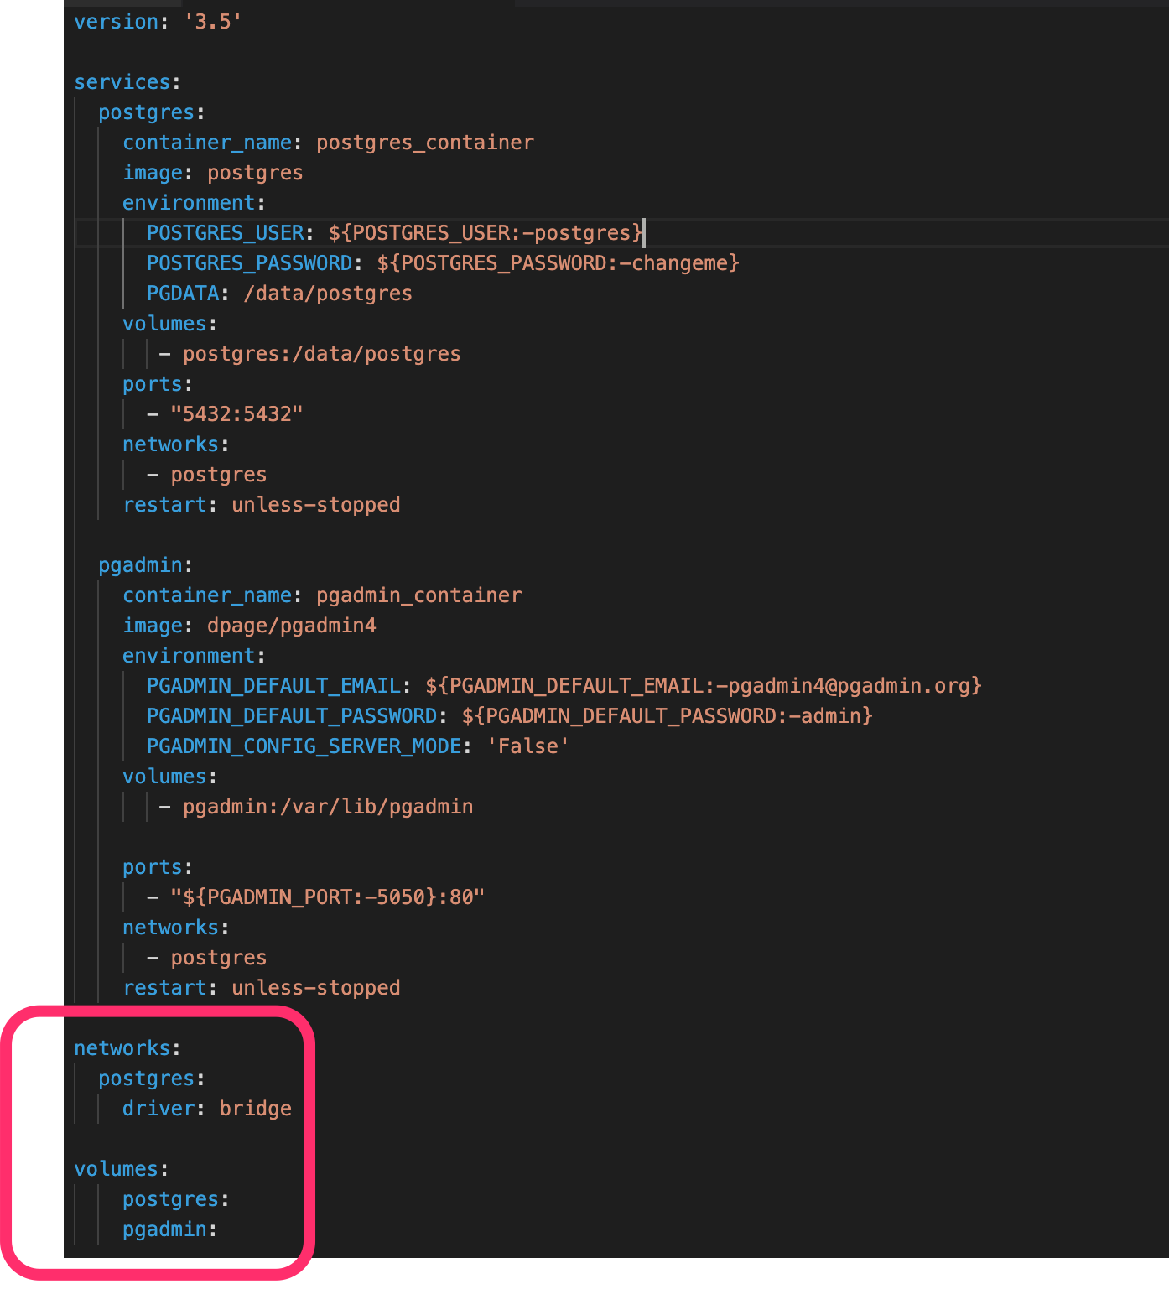
Structure: declarations
If you have use a network, secret, volumes on one and or more of your service you have to declare them at the end.
declaration

Slide 27
Structure: sample compose files
https://github.com/docker/awesome-compose

Slide 28
Structure: Generate compose file
Now that you know the structure and options use this tools to generate your compose file avoid the stress of writing this from scratch
https://8gwifi.org/dc.jsp

Slide 29
Structure: Generate compose file
Now that you know the structure and options use this tools to generate your compose file avoid the stress of writing this from scratch
https://8gwifi.org/dc.jsp

